Slide 1


Buildable DIGITAL HEALTH BLUEPRINT
Developing “construction” documents and an
investment and implementation roadmap for the national HIE
Digital Health Building Blocks
[Date].

Slide 2

WORKSHOP PLAN…
Leverage each successive workshop to progress the development of the blueprint:
Use cases (choosing our initial care pathways)
Digital health specifications (Integration Profiles)
“Building blocks” (conformant solutions)
Implementation science (making it “go”)
Each session builds on the one before it…

Slide 3

Workshop-3 Building Blocks

Slide 4
WORKSHOP-3 AGENDA
Brief recap and review
Landscape: what digital health solutions are broadly deployed, now?
Opportunities:
Which solutions could potentially be leveraged to accelerate the construction of the national HIE infrastructure?
Which POS solutions will help us generate implementation momentum when we connect them to the HIE (e.g. via a façade, etc.)?
Next steps

Slide 5

Which digital health solutions have already been taken to national scale?

Slide 6
WHAT IS THE CURRENT LANDSCAPE?
<lookup country entries on the Global Digital Health Atlas; prepare a set of slides summarizing the findings: https://digitalhealthatlas.org/en/-/>
<leverage a desk review and pre-workshop interviews with MOH to augment the findings from the Atlas. Prepare a set of slides to depict the findings.>
<cross reference findings from steps 1 & 2 to the Digital Square Global Goods for Health (https://digitalsquare.org/digital-health-global-goods) listing and the Digital Public Goods Alliance (https://digitalpublicgoods.net/registry/) listing. Prepare slides that summarize the findings.>

Slide 7
INTERACTION 3.1
<paste Form link here>
Share Form 3.1 with attendees or with MOH teammates ahead of WS-3
Prepare a set of slides that report the results collected using Form 3.1 and share these with the WS-3 attendees. NOTE: flag errors, if you find them – especially cases where existing POS solutions are flagged as candidates for HIE-level deployment.

Slide 8

KEY TAKEAWAY POINTS
<List three or four key takeaway points, here>

Slide 9

Questions and Answers?

Slide 10

Do any of our existing solutions afford us opportunities to accelerate our HIE implementation?

Slide 11
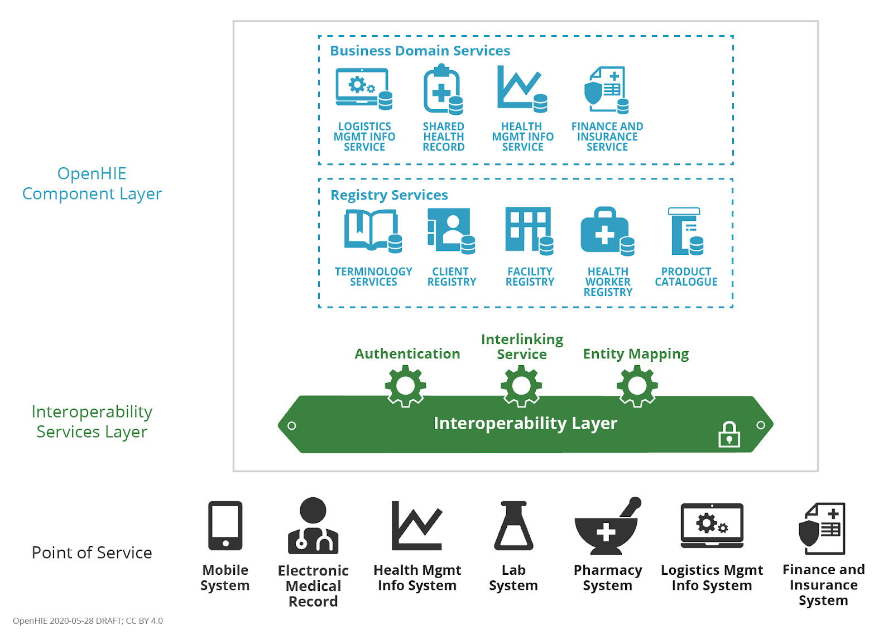

REMINDER
Leveraging the terms used to describe the OpenHIE architecture, which existing solutions could play which actor roles in our national HIE?

Slide 12



Client Registry (CR)
The CR is the definitive all-persons registry of demographic data about each individual, including their unique ID for health.
Interlinked Facility Registry (ILR-FR)
The ILR-FR is a definitive registry of all health facilities, both private and public sector. It includes information about the location, services and operating times – and is the source of the facility’s unique ID.
Interlinked Health Worker Registry (ILR-HWR)
The ILR-HWR is a definitive registry of all health workers, both private and public sector. It includes demographic information about the health worker including their cadre and where they provide services. It is the normative source of the worker’s unique ID.

Slide 13



Terminology Service
The TS is a normative repository of the national digital health codes and the relationships between them.
Organizations Registry (ILR-ORG)
The ILR-FR is a definitive repository of health system organizations and the relationships between them.
Health Management Information System (HMIS)
A Health Management Information System is a database system explicitly designed and optimized for conducting and generating analyses of health system data.
Share Health Record Repository (SHR)
The SHR is the HIE’s repository of person-centric information that establishes each individual's longitudinal electronic health record.

Slide 14


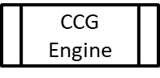
Interoperability Layer (IL)
The Interoperability Layer is sometimes called an enterprise services bus (ESB). It is a digital health architectural element that coordinates and audits transactions submitted by authenticated systems.
Point-of-Service solution (POS)
The POS solutions are the ones that are used by humans to support care encounters. These include electronic medical records (EMR) solutions, lab systems, pharmacy systems, diagnostic imaging solutions, dentistry solutions, patient-facing apps, etc.
Computable Care Guidelines Engine (CCG)
POS solutions that perform clinical decision support may do so through using a CCG engine to process care guidelines that have been published in a standards-based, computable, format.s

Slide 15

IMPORTANT NOTES…
Existing POS solutions can almost never be used as “HIE elements”. The design of a system targeted for human use is typically very different from that of a web service.
Existing data, however, can give us a good running start if we import it into a high-performance web service.

Slide 16

Questions and Answers?

Slide 17
INTERACTION 3.2
<paste Form link here>
Can we leverage existing digital health solutions as:
Terminology Service / Health Services Directory
Client Registry
Health Worker Directory / Registry
Facility Directory / Registry
Organization Directory / Registry
Shared Health Record Repository
Health Management Information System
Interoperability Layer (security, auditing, etc.)
POINT of SERVICE (POS) Solutions (EMRs, mHealth apps, etc.)

Slide 18

For those legacy solutions we want to leverage… how do we ensure they are “ready to connect”?

Slide 19
DESIGN PRINCIPLES
REMINDER
The recommended HIE deployment model is cloud-hosted.
An online transaction processing (OLTP) FHIR Server will be optimized for performance.
In order to defend its performance, batch, maintenance, or analytics-focused processing will operate separately from the OLTP FHIR Server.
It is expected an enterprise service bus will orchestrate transactions and will centralize security, privacy, and auditing.
POS solutions that operate in an occasionally offline mode will be expected to leverage local caching and have a synchronization capability once re-connected.

Slide 20
LEVERAGING LEGACY SOLUTIONS
REMINDER
There may be architectural elements have been deployed and taken to scale.
Where practical, these legacy solutions will be incorporated into the HIE. This will be accomplished by developing a standards-conformant wrapper (a façade) for the existing solution.
The façade will be used to add a communications interface to the legacy solution that adheres to the HIE’s normative transaction processing specifications.
Loose coupling will be favoured; this will best defend OLTP performance of the HIE’s FHIR Server.

Slide 21


REMINDER
Legacy
Software
Solution
Standards-based Interface
Proprietary
Interface
The software façade ingests the legacy software solution’s proprietary interface, applies mapping and translation routines, and exposes the transformed messages via a standards-based interface. A façade can be constructed to operate as a 1-way or as a 2-way communications interface.

Slide 22


Examples: Legacy Solutions
with FHIR-conformant wrappers
ORG
REMINDER
Interoperability Layer
(16)
(16)
(16)
(16)
OLTP FHIR Server
(2)
(9)
TS*
(5)
ILR/TS
ILR-HWR
ILR-FR
ILR-ORG
SHR
HMIS
CR*
CR
(7)
(10)
(11,12,13,14)
(10)
(10)
(10)
(8)
(9)
(9*)
(15)
(7)
ATNA
(8)
(9)
(10)
(11,12,13,14)
(15)
(1)
(Maintenance/batch transactions)
(Real-time runtime transactions)
CR*
POS
(6)
POS
Solution
(9)
CCG
Engine
(17)

Slide 23
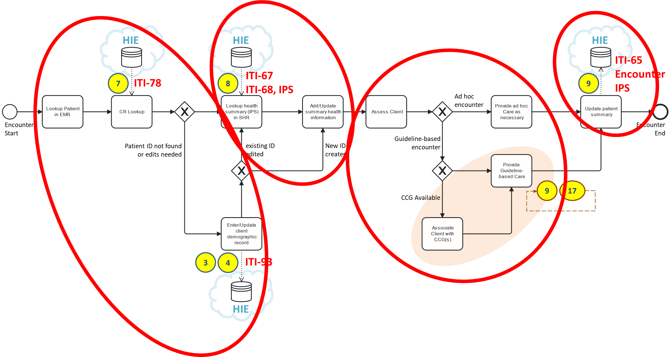

These mandatory POS behaviours can be thought of as a simple 1-2-3-4 pattern (like in a dance).
REMINDER
Unambiguously identify the subject of care.
Retrieve the subject’s health summary.
Update the subject’s health summary
Based on the summary, and on the current situation, provide appropriate care.

Slide 24

IMPORTANT NOTES…
Our choices regarding the HIE architecture (Workshop-2) should be officially adopted by the MOH. These become our national norms and standards for digital health.
All digital health solution need to demonstrably conform to these national norms before they can be allowed to connect to our HIE.

Slide 25

Questions and Answers?

Slide 26
INTERACTION 3.3
<paste Form link here>
Who should conduct the digital health conformance-testing?
How will necessary software updates be paid for?
How long should point of service (POS) solutions be given to become conformant?
What supports should be made available to help solutions achieve conformity?

Slide 27
NEXT STEPS…WORKSHOP 4
Explore the governance and legal aspects related to deploying a national HIE.
Evaluate different implementation options and their trade-offs.
Inform the notional project schedule, and best-guess deployment assumptions, that will yield a pro forma investment rationale for the HIE project.
REMEMBER
You will need your PC, tablet, or smartphone
to fill in the questionnaires.

